Slide 1

User Testing

Slide 2
Iterative Development Process
Analysis
Design
Implementation
Requirements
Planning
Initial Planning
Testing
Evaluation
Deployment

Slide 3

Today
What is user testing?
Why user test?
Methods
Measurements
Prototypes
How to apply to your projects
In-class activity

Slide 5
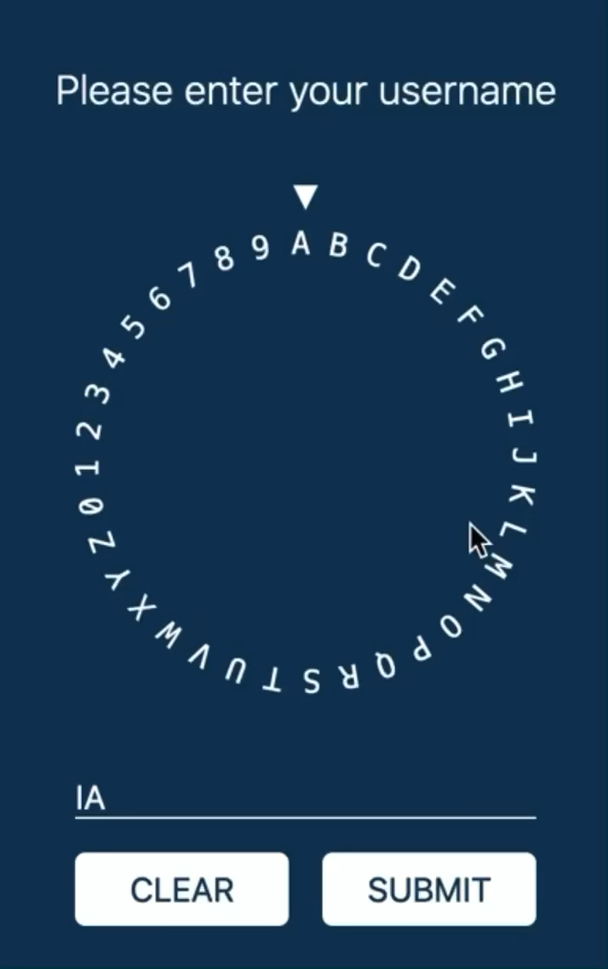

Slide 6
How do we test usability?
Intuition?
Test on ourselves?
Copy interface from other apps?
Not worry about it until someone gets injured?

Slide 7
Test with actual USERS
Many different methods of testing
Put your app in front of actual people
Can they figure it out?
How long does it take them?
Do they need help?
How they behave != how you want them to behave
Don’t blame the user!
Blame the design and go fix it!
Don’t wait until the end to test with users

Slide 8

Why user test? The “yes…but” problem
Yes, that’s what I asked for, but now that I try it, what I really need is something slightly different.
Quickly find flaws in your
design or implementation.

Slide 9
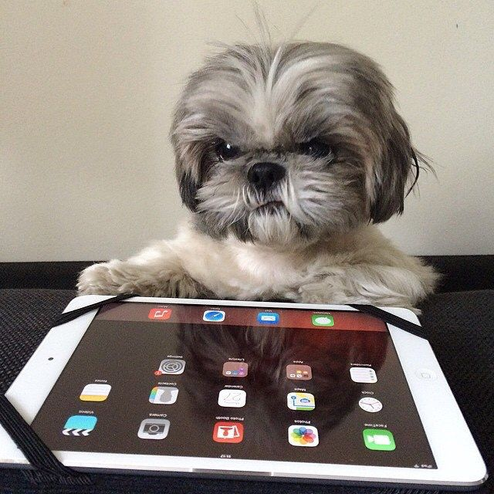
Low-cost user testing
Ask a few people to try your app every few weeks
Can they figure it out without help?
Give them a task with it… do they do it as you expected?
What problems might there be with this method?

Slide 10
“Dogfooding”
Use your own product.
Helps close the gap between user and developer.

Slide 11
User study methods
Interviews
Surveys
Shadowing
Lab study
Field study
Wizard of Oz
Focus group
Retrospective study
Diary study
A/B testing
Pros/cons of each
Each answers different questions
Often use multiple

Slide 12

Lab study
Controlled setting with complete control over tasks
Common to record the participant and the screen
Can be formal or informal
Many possibly tasks
Based on your user stories
Ask them to complete the same task using two different apps
Metrics: task time, correctness, mistakes, opinions
Beward of reactivity effects
Do they use the app as you expected?

Slide 13
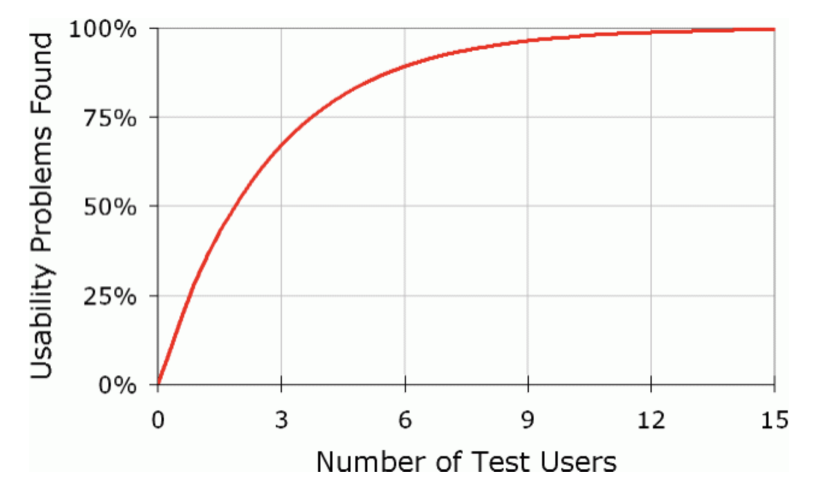
Revealing usability concerns

Slide 14
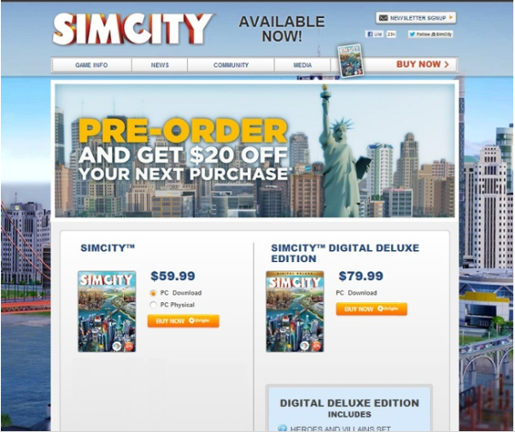
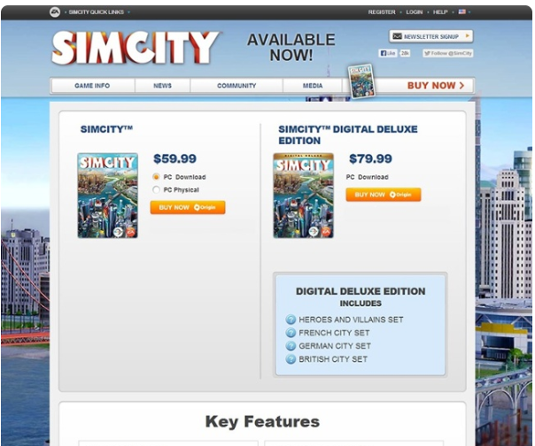
A/B testing
43% more purchases

Slide 15
A/B Testing
Compare two variations of a design
Often used for web pages with a call to action
Randomly show a user design A or B
Does design A or B lead to more sales/signups/clicks?
Requires many users
Is there a statistically significant difference?
Doesn’t tell you why

Slide 16

Shadowing
“Fly on the wall”
Observe people in their own setting… often work
Rich qualitative data
Expensive!
Time consuming
Difficult to get access

Slide 17

Interview & Survey
Open-ended questions show the users perspective
Users will surprise you
Don’t ask leading questions
“How much do you love my app?”
Responses don’t always match behavior
Scalable
“Do you want this feature?” “YES!”

Slide 18
What biases does each of these methods have?
Notes:
Survey? Lab study?

Slide 19
You don’t even need a working app!

Slide 20
Prototyping
Implementing a full feature/product is expensive
Prototype to gather requirements first
Mockups/wireframes
Paper prototype
Wizard of Oz

Slide 21
Paper prototype

Slide 22
Wizard of Oz

Slide 23
Wireframes

Slide 24
What is a usability?
ISO 9241-11: “the extent to which a product can be used by specified users to achieve specified goals with effectiveness, efficiency and satisfaction in a specified context of use.”
Learnability, Efficiency, Memorability, Errors, Satisfaction

Slide 25
Aspects of Usability
Learnability
Efficiency
Satisfaction
Memorability
Errors

Slide 26
Learnability
Can users learn to correctly use it?
Can unfamiliar users pick it up?
Can power users learn to become experts with it?
How to provide the right guidance to help users?
They won’t read instruction books!
Wizards?
Visible & labeled buttons

Slide 27
Notes:
Could use wizards to guide them through complex processes.

Slide 28
Notes:
Could provide suggestions and templates to common tasks.

Slide 29
Design constraint:
Don’t overwhelm the user
Make it easy to find features

Slide 30
How could we measure learnability?

Slide 31
Aspects of Usability
Learnability
Efficiency
Satisfaction
Memorability
Errors

Slide 32
Efficiency
How fast can users perform the correct interaction?
How do you design interfaces for faster interactions?

Slide 35
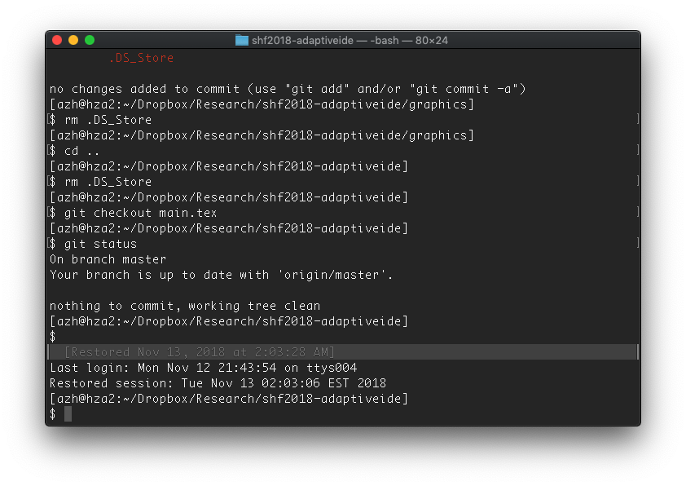

Slide 37
Design constraint:
Let experts be fast
Let novices learn

Slide 38
How could we measure efficiency?

Slide 39
Errors
Is it unlikely that users will make errors?
Is it easy to recover from errors?

Slide 40
Make it hard to make mistakes
Unambiguous buttons
Clear descriptions
No surprises!
Every action should be revertable*

Slide 41
Revertable!
Ever close a tab on accident?
Reopen tab
Ever close all your tabs?
Reopen all
Ever close Chrome?
Recent update made it harder
Delete a file?
Trash
Changed a file?
Undo
Clicked the Next button?
Previous
For permanent things…
Ask if they are sure.
Consider a delay.

Slide 42
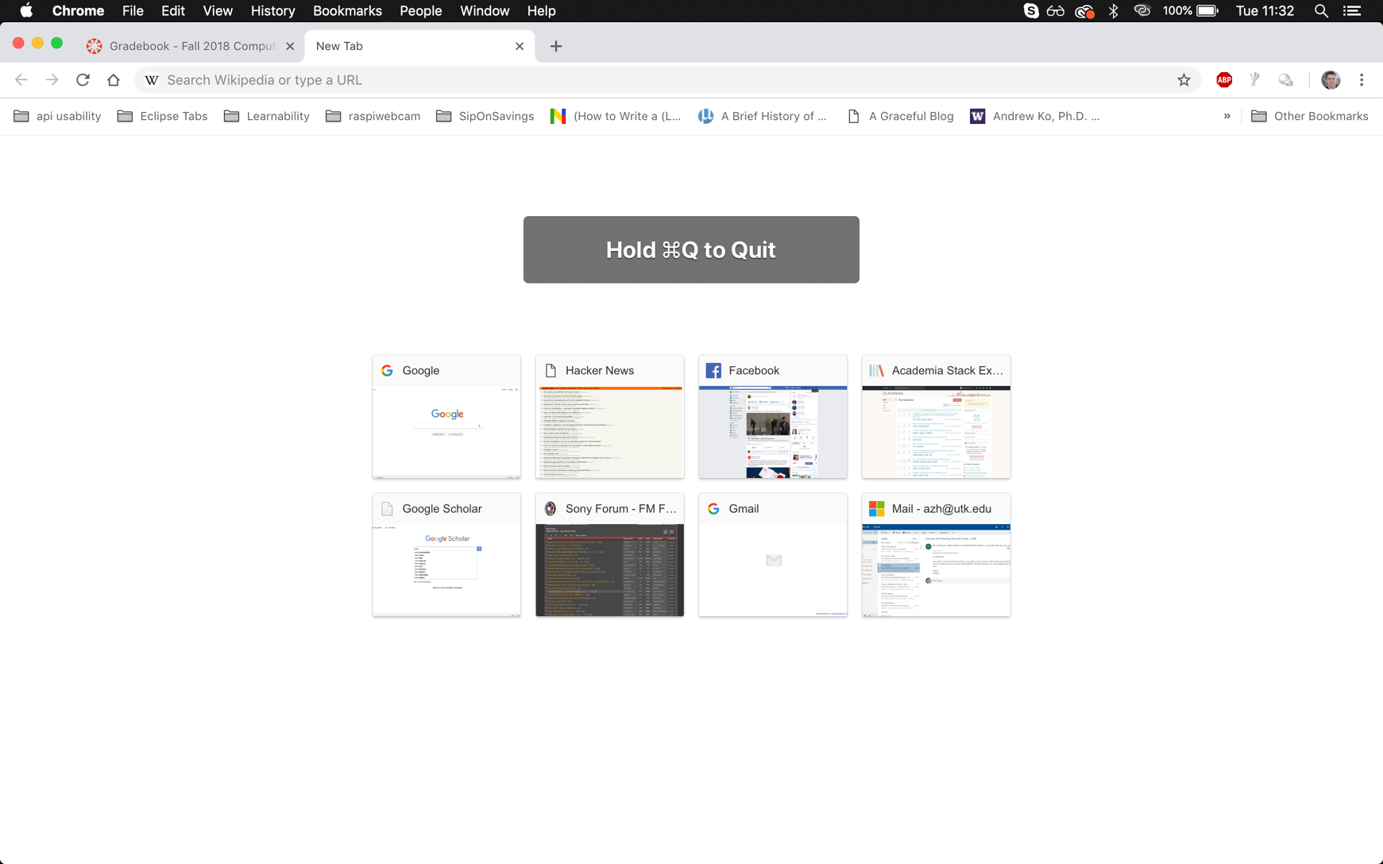

Slide 43
How could we measure errors?

Slide 44
Aspects of Usability
Learnability
Efficiency
Satisfaction
Memorability
Errors

Slide 45
Process of Usability Engineering
Design
Implement
Evaluate

